Slide 1
Sliding Window Protocols
Prepared by
Divya K S
Adi Shankara Institute of Engineering & Technology
Kalady

Slide 2
Elementary Data Link Protocols
An Unrestricted Simplex Protocol
A Simplex Stop-and-Wait Protocol
A Simplex Protocol for a Noisy Channel

Slide 3
An Unrestricted Simplex Protocol
Simplex - Data are transmitted in one direction only.
Both the transmitting and receiving network layers are always ready.
Processing time can be ignored.
Infinite buffer space is available.
Communication channel between the data link layers never damages or loses frames.
This is thoroughly an unrealistic protocol, so it is nicknamed as “utopia”

Slide 4
A Simplex Stop-and-Wait Protocol
Data traffic – simplex
Error free communication channel
Protocols in which the sender sends one frame and then waits for an acknowledgment before proceeding are called Stop-and-Wait Protocol

Slide 5
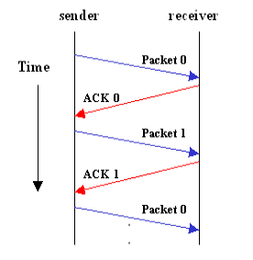
A Simplex Stop-and-Wait Protocol

Slide 6
A Simplex Protocol for a Noisy Channel
Data are transmitted in one direction only.
Channel is not error free
Frames may be either damaged or lost completely

Slide 7
Sliding Window Protocols
In the previous protocols, data frames were transmitted in one direction only.
In most practical situations, there is a need for transmitting data in both directions.
One way of achieving full-duplex data transmission is to have two separate communication channels and use each one for simplex data traffic (in different directions).
If this is done, we have two separate physical circuits, each with a ''forward'' channel (for data) and a ''reverse'' channel (for acknowledgements).
In which cases, the bandwidth of the reverse channel is almost entirely wasted.
In effect, the user is paying for two circuits but using only the capacity of one
A better idea is to use the same circuit for data in both directions.

Slide 8
Sliding Window Protocols-piggybacking
When a data frame arrives, instead of immediately sending a separate control frame, the receiver restrains itself and waits until the network layer passes it the next packet.
The acknowledgement is attached to the outgoing data frame (using the ack field in the frame header).
In effect, the acknowledgement gets a free ride on the next outgoing data frame.
The technique of temporarily delaying outgoing acknowledgements so that they can be hooked onto the next outgoing data frame is known as piggybacking

Slide 9
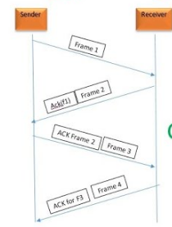
Piggybacking

Slide 10
Sliding Window Protocols
The principal advantage of using piggybacking over having distinct acknowledgement frames
better use of the available channel bandwidth.
The ack field in the frame header costs only a few bits, whereas a separate frame would need a header, the acknowledgement, and a checksum.
Other advantages:
In addition, fewer frames sent means fewer ''frame arrival'' interrupts,
fewer buffers required in the receiver, depending on how the receiver's software is organized.

Slide 11
Sliding Window Protocols
In all sliding window protocols, each outbound frame contains a sequence number, ranging from 0 up to some maximum
Maximum is usually 2^{n} - 1 so the sequence number fits exactly in an n-bit field.
The stop-and-wait sliding window protocol uses n = 1, restricting the sequence numbers to 0 and 1

Slide 12
Sliding Window Protocols
Essence of all sliding window protocols
at any instant of time, the sender maintains a set of sequence numbers corresponding to frames it is permitted to send.
These frames are said to fall within the sending window.
Similarly, the receiver also maintains a receiving window corresponding to the set of frames it is permitted to accept.

Slide 13
Sliding Window Protocols
The sequence numbers within the sender's window represent frames that have been sent or can be sent but are as yet not acknowledged.
Whenever a new packet arrives from the network layer, it is given the next highest sequence number, and the upper edge of the window is advanced by one.
When an acknowledgement comes in, the lower edge is advanced by one. In this way the window continuously maintains a list of unacknowledged frames.
Since frames currently within the sender's window may ultimately be lost or damaged in transit, the sender must keep all these frames in its memory for possible retransmission.

Slide 14
Sliding Window Protocols
Thus, if the maximum window size is n, the sender needs n buffers to hold the unacknowledged frames.
If the window ever grows to its maximum size, the sending data link layer must forcibly shut off the network layer until another buffer becomes free
The receiver window corresponds to the frames it may accept.
Any frame falling outside the window is discarded without comment.
When a frame whose sequence number is equal to the lower edge of the window is received, it is passed to the network layer, an acknowledgement is generated, and the window is rotated by one.
Unlike the sender's window, the receiver's window always remains at its initial size.
Note that a window size of 1 means that the data link layer only accepts frames in order
Size n means it will receive out of order

Slide 15
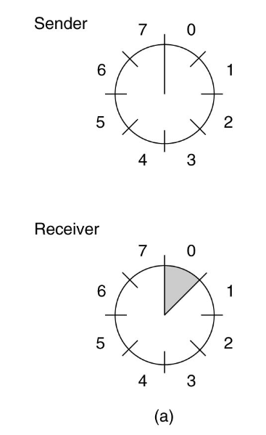
At start. Receiver waits for 0.

Slide 16
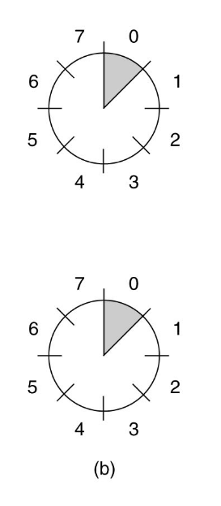
Sender sends 0.

Slide 17
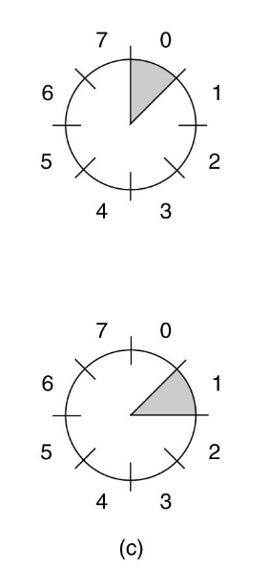
Receiver receives 0. Waits for 1.

Slide 18
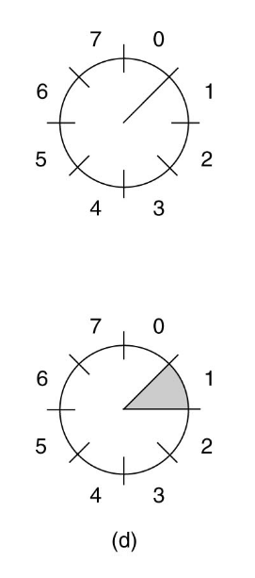
Sender got ack for 0. Hasn't got 1 from its Network layer yet.

Slide 19
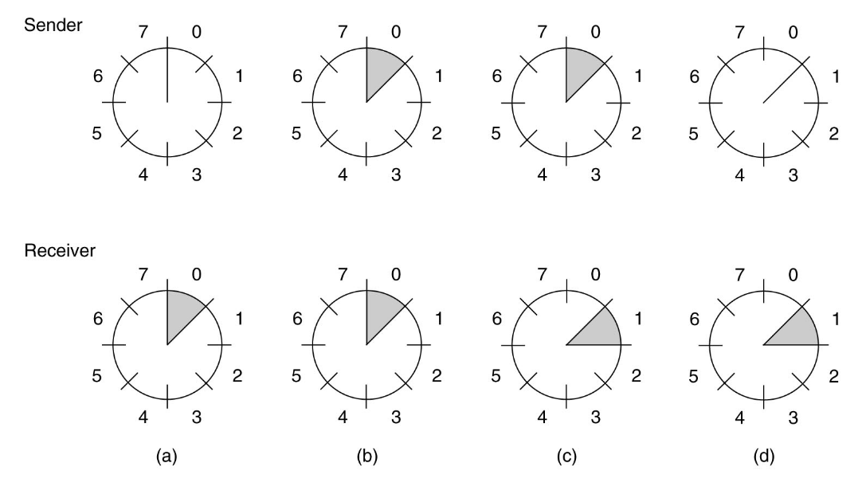

Slide 20
Sliding Window Protocols
A One-Bit Sliding Window Protocol
A Protocol Using Go Back N
A Protocol Using Selective Repeat
Three protocols differ among themselves in terms of efficiency, complexity, and buffer requirements

Slide 21
A One-Bit Sliding Window Protocol
A sliding window protocol with a maximum window size of 1.
Such a protocol uses stop-and-wait since the sender transmits a frame and waits for its acknowledgement before sending the next one
starting machine fetches the first packet from its network layer, builds a frame from it, and sends it.
When this frame arrives, the receiving data link layer checks to see if it is a duplicate
If the frame is the one expected, it is passed to the network layer and the receiver's window is slid up

Slide 22
A One-Bit Sliding Window Protocol
The acknowledgement field contains the number of the last frame received without error.
If this number agrees with the sequence number of the frame the sender is trying to send, the sender knows it is done with the frame stored in buffer and can fetch the next packet from its network layer.
If the sequence number disagrees, it must continue trying to send the same frame.

Slide 23
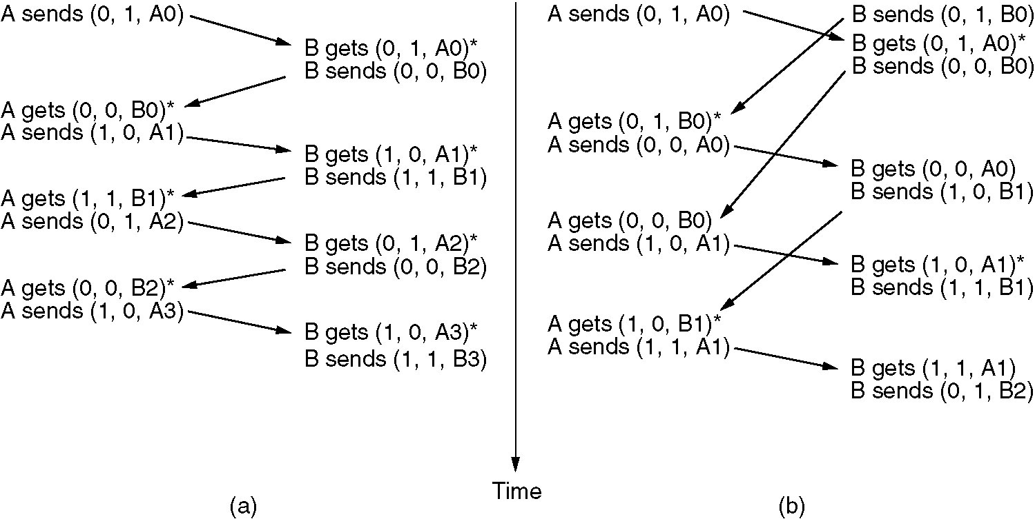
A One-Bit Sliding Window Protocol
Scenario (a) Normal case.
The notation is (seq, ack, packet number).
An asterisk indicates where a network layer accepts a packet.

Slide 24
A One-Bit Sliding Window Protocol
Scenario (b) Abnormal case .
The notation is (seq, ack, packet number).
An asterisk indicates where a network layer accepts a packet.

Slide 25
Sliding Window Protocol Using Go Back N
Until now we have made the assumption that the transmission time required for a frame to arrive at the receiver plus the transmission time for the acknowledgement to come back is negligible.
Sometimes this assumption is clearly false.
In this case we cant have stop and wait .
Another problem is that most of the bandwidth of the channel is wasted
The above problem can be solved by a technique known as pipelining.
In this technique we set the sender window size so large that the sender is allowed to transmit multiple frames until the acknowledgement for the first frame comes back
There after acknowledgement will arrive one after another so the sender always get permission to transmit

Slide 26
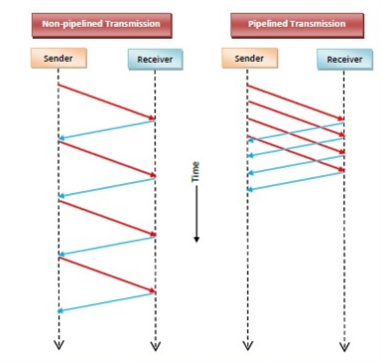

Slide 27
Sliding Window Protocol Using Go Back N
problem with pipelining is that what happens if a frame in the middle of a long stream is damaged or lost?
Large numbers of succeeding frames will arrive at the receiver before the sender even finds out that anything is wrong.
When a damaged frame arrives at the receiver, it obviously should be discarded, but what should the receiver do with all the correct frames following it?
Two basic approaches are available for dealing with errors in the presence of pipelining.
A Protocol Using Go Back N
A Protocol Using Selective Repeat

Slide 28
Protocol Using Go Back N
In go back n, is for the receiver simply to discard all subsequent frames, sending no acknowledgements for the discarded frames.
This strategy corresponds to a receive window of size 1.
In other words, the DLL refuses to accept any frame except the next one it must give to the network layer.
If the sender's window fills up before the timer runs out, the pipeline will begin to empty.
After time out the sender will time out and retransmit all unacknowledged frames in order, starting with the damaged or lost one.
This approach can waste a lot of bandwidth if the error rate is high.

Slide 29
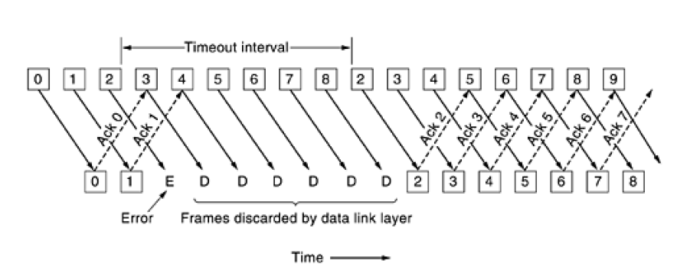
Protocol Using Go Back N

Slide 30
Sliding Window Protocol Using Selective Repeat
Other general strategy for handling errors when frames are pipelined is called selective repeat.
When it is used, a bad frame that is received is discarded, but good frames received after it are buffered.
When the sender times out, only the oldest unacknowledged frame is retransmitted.
If that frame arrives correctly, the receiver can deliver to the network layer, in sequence, all the frames it has buffered.
Selective repeat is often combined with having the receiver send a negative acknowledgement (NAK) when it detects an error, for example, when it receives a checksum error or a frame out of sequence.
NAKs stimulate retransmission before the corresponding timer expires and thus improve performance

Slide 31
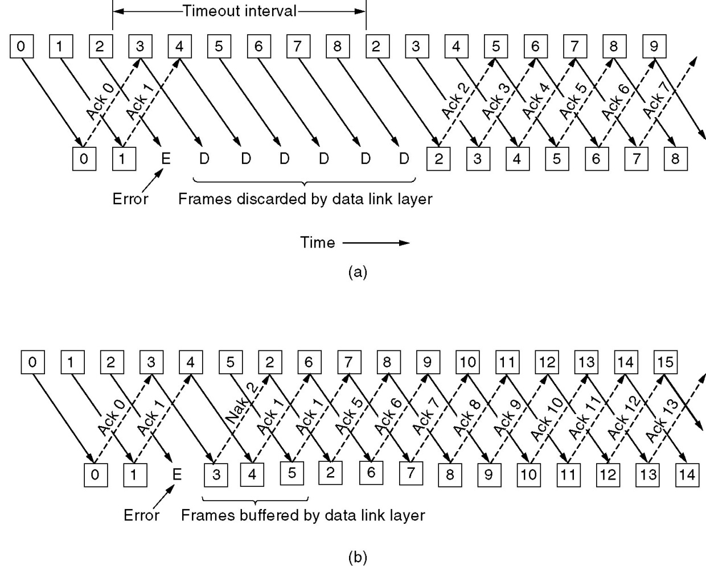
Sliding Window Protocol Using Selective Repeat
4
5
2

Slide 32
Sliding Window Protocol Using Selective Repeat
Frames 0 and 1 are again correctly received and acknowledged and frame 2 is lost.
When frame 3 arrives at the receiver, the DLL notices that is has missed a frame
So it sends back a NAK for 2 but buffers 3.
When frames 4 and 5 arrive, they, too, are buffered by the DLL instead of being passed to the network layer.
Eventually, the NAK 2 gets back to the sender, which immediately resends frame 2. When that arrives, the DLL now has 2, 3, 4, and 5 and can pass all of them to the network layer in the correct order.
It can also acknowledge all frames up to and including 5
If the NAK should get lost, eventually the sender will time out for frame 2 and send it, but that may be a quite a while later

